Slide 1
Mathematic for Computer Science - III CS203B
Lecture 6:
Linearity of expectation

Slide 2
Homework from last class

Slide 3
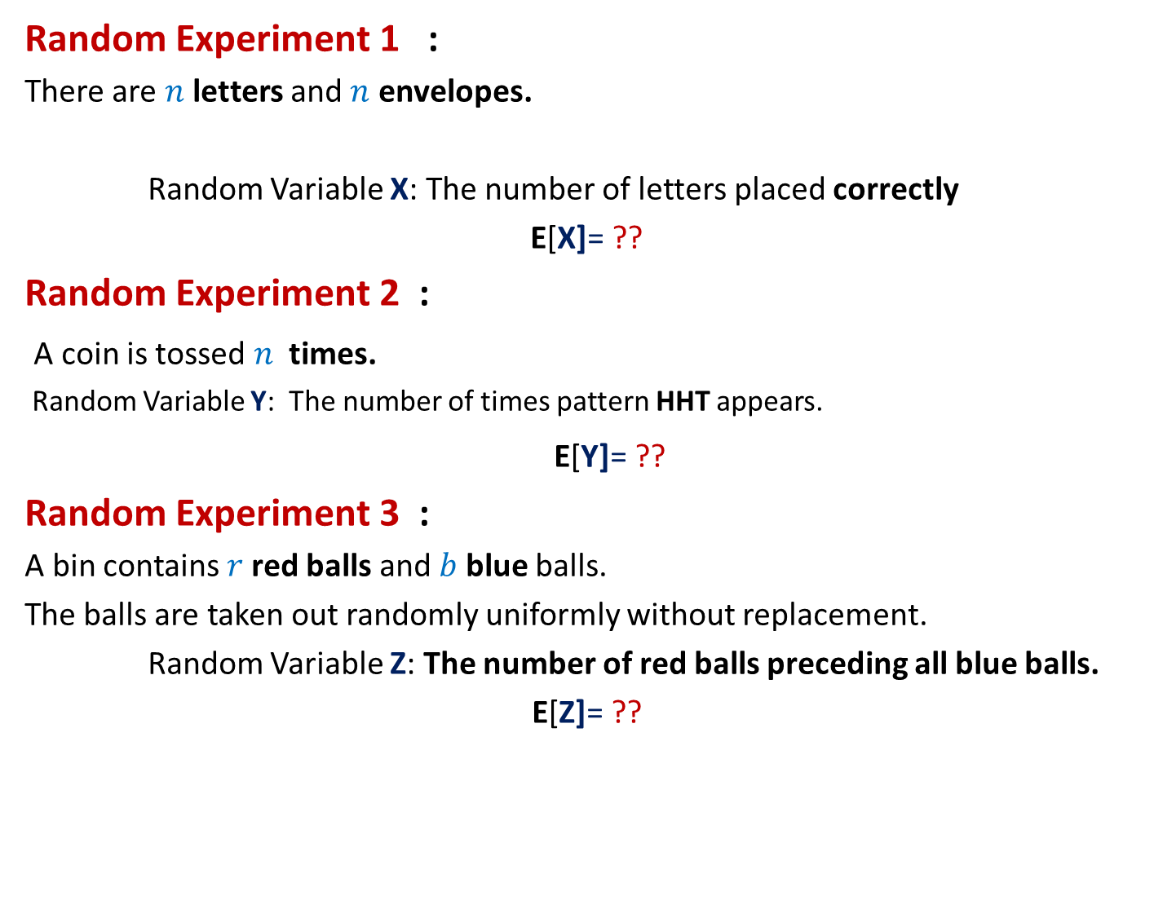
Can we solve these problems ?
Random Experiment 1 :
There are $n$letters and $n$ envelopes.
Random Variable X: The number of letters placed correctly
E[X]= ??
Random Experiment 2 :
A coin is tossed $n$ times.
Random Variable Y: The number of times pattern HHT appears.
E[Y]= ??
Random Experiment 3 :
A bin contains $r$red balls and $b$ blue balls.
The balls are taken out randomly uniformly without replacement.
Random Variable Z: The number of red balls preceding all blue balls.
E[Z]= ??

Slide 4

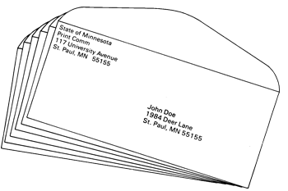

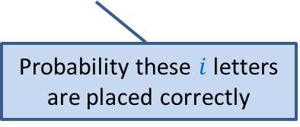

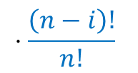





Problem 1: Letters and envelopes
There are $n$ letters
There are $n$envelopes with distinct addresses written on them.
Each letter is meant for a unique envelope.
Random Variable X: The number of letters correctly placed.
Question: What is E[X] ?
E[X] = $\sum_{i}{i⋅ \text{P}\text{(}\text{X}\text{ =} i\text{)}}$
Letters are assigned randomly uniformly to the envelopes, one by one.
It appears too complicated
to compute E[X].
$$\left(\begin{matrix}n \\ i\end{matrix}\right)$$
$$⋅\frac{\left(n−i\right)!}{n!}$$
$\text{P}\text{(}\text{X}\text{ =} i$) =
($1 −$
P(at least one of $n−i$letters is correctly placed)
$⋅ \text{P}\text{(} \text{none} \text{of} \text{the} \text{remaining} n−i \text{letters} \text{are} \text{placed} \text{correctly}$ )
No. of ways of choosing $i$ letters
Probability these $i$ letters are placed correctly
$$\frac{1}{2!}−\frac{1}{3!}+\frac{1}{4!}− …{\left(−1\right)}^{n−i}\frac{1}{(n−i)!}$$

Slide 5





Problem 2: Pattern HHT in $n$ tosses of a fair coin
A fair coin is tossed $n$times.
Random Variable Y: The number of times pattern HHT appears.
Question: What is E[Y] ?
E[Y] = $\sum_{i}{i⋅ \text{P}\text{(}\text{Y}\text{ =} i\text{)}}$
$f(n)$ :
Expected no. of times HHT appears in $n$ tosses
It appears too complicated
to compute E[Y].
Recursive formulation

Slide 6


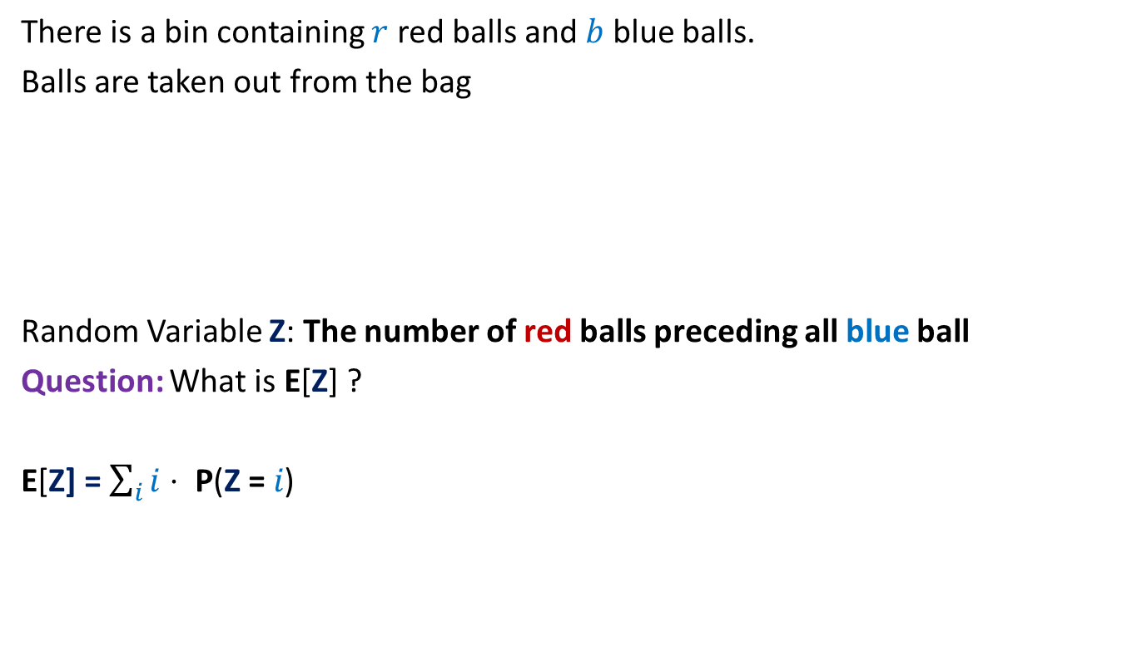

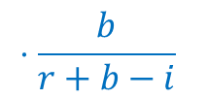
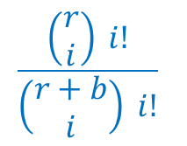
Problem 3: Balls Out of Bag
There is a bin containing $r$ red balls and $b$ blue balls.
Balls are taken out from the bag
Random Variable Z: The number of red balls preceding all blue ball
Question: What is E[Z] ?
E[Z] = $\sum_{i}{i⋅ \text{P}\text{(}\text{Z}\text{ =} i\text{)}}$
uniformly randomly
and without replacement.
…
$i$ red balls
$1$ blue ball
It appears too complicated
to compute E[Z].
$$\frac{\left(\begin{matrix}r \\ i\end{matrix}\right) i!}{\left(\begin{matrix}r+b \\ i\end{matrix}\right) i!}$$
$$⋅\frac{b}{r+b−i}$$
$\text{P}\text{(}\text{Z}\text{ =} i$) =

Slide 7




Since viewing the random experiment in its entirety looks so complex, let us take a microscopic view.
$n$Letters into $n$envelopes
The number of letters correctly placed into envelopes
$r$red balls and $b$blue balls
The number of red balls preceding all blue balls
Tossing a coin $n$times blue balls
HHTHTHHTTTHHTHTHHHHTTHHTHH
The number of times HHT pattern appears

Slide 8

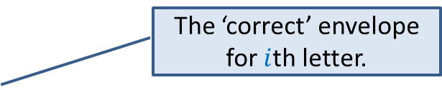
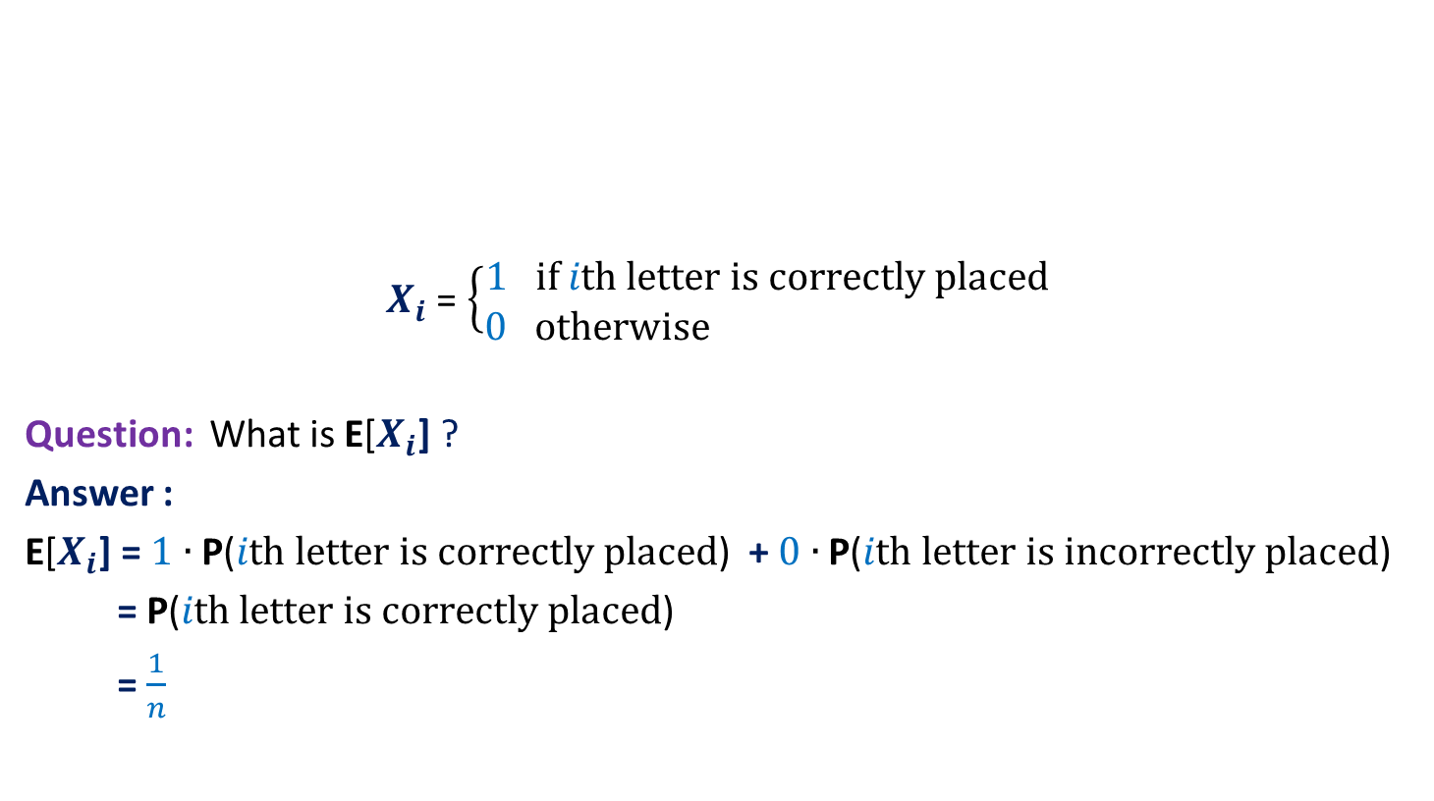


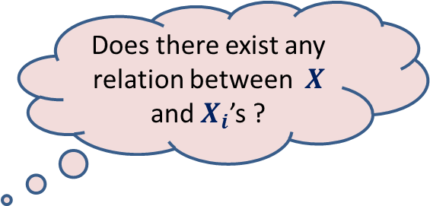
Problem 1: Letters and envelopes
$X_{i}$ = $\left\{\begin{matrix}1 if ith letter is correctly placed \\ 0 otherwise \end{matrix}\right.$
Question: What is E[$X_{i}$] ?
Answer :
E[$X_{i}$] = $1$ $∙$ $\text{P}\text{(}ith letter is correctly placed\text{) }$ + $0$ $∙$ $\text{P}\text{(}ith letter is incorrectly placed\text{) }$
= $\text{P}\text{(}ith letter is correctly placed\text{)}$
= $\frac{1}{n}$
$i$th
letter
What would you focus on while taking microscopic approach of this experiment?
Each letter is equally likely to be placed in this envelope. So…
We can define random variable $X_{i}$ for each $1≤i≤n$
The ‘correct’ envelope for $i$th letter.
Does there exist any relation between $X$ and $X_{i}$’s ?
It is so easy and compact

Slide 9


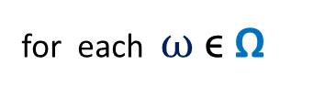

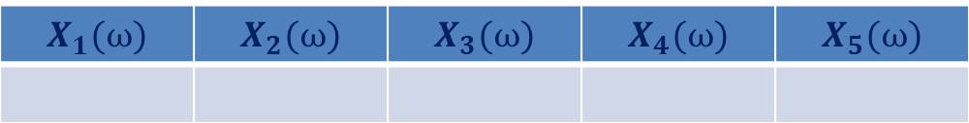
Problem 1: Letters and envelopes
$$n=5$$
Consider any elementary event.
$X\left(ω\right)=2$
1 2 3 4 5
number of letters
correctly placed
An elementary event
$$ω$$
1 2 3 4 5
$$X_{1}(ω)$$ | $$X_{2}(ω)$$ | $$X_{3}(ω)$$ | $$X_{4}(ω)$$ | $$X_{5}(ω)$$
0
1
0
1
0
$X\left(ω\right)=$ $X_{1}\left(ω\right)+$ $X_{2}\left(ω\right)+$ $X_{3}\left(ω\right)+$ $X_{4}\left(ω\right)+$ $X_{5}\left(ω\right)$
for each $ω$ ϵ Ω

Slide 10

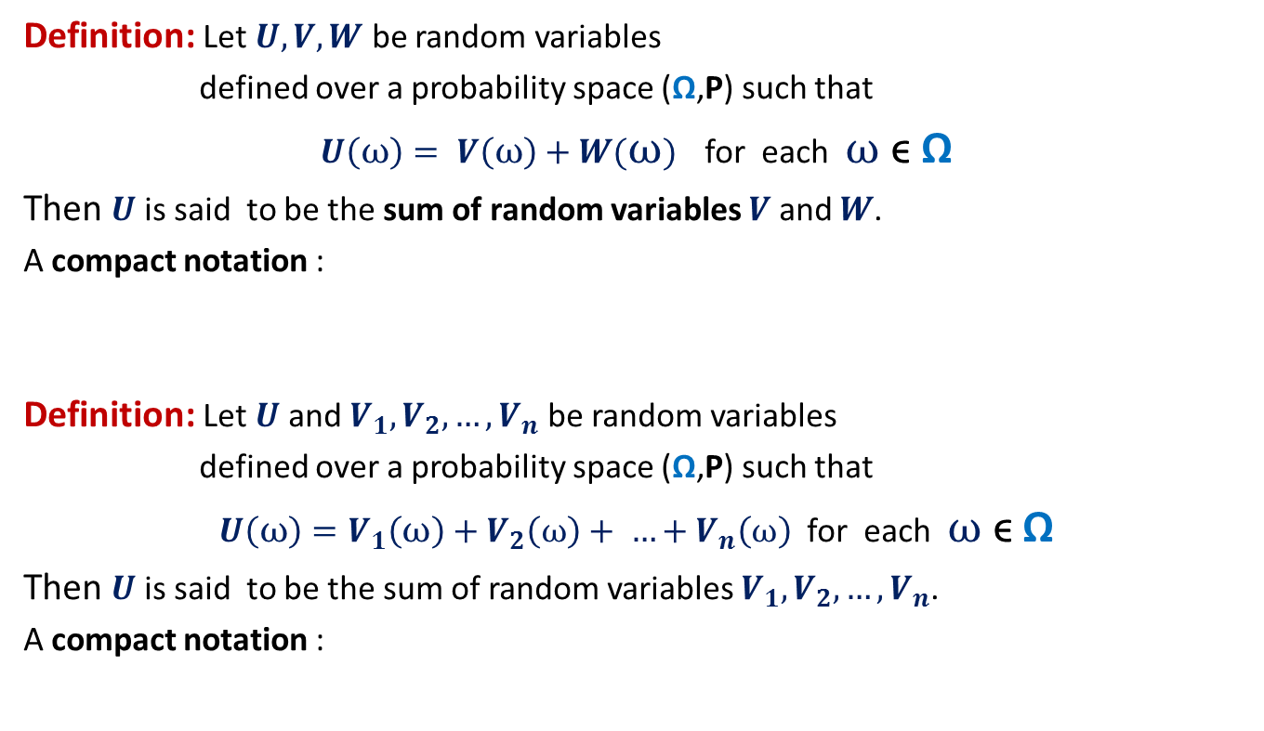

Sum of Random Variables
Definition: Let $U,V,W$ be random variables
defined over a probability space (Ω,P) such that
$U\left(ω\right)= V\left(ω\right)+W(ω)$ for each $ω$ ϵ Ω
Then $U$ is said to be the sum of random variables $V$ and $W$.
A compact notation :
Definition: Let $U$and $V_{1},V_{2},…,V_{n}$ be random variables
defined over a probability space (Ω,P) such that
$U\left(ω\right)=V_{1}\left(ω\right)+V_{2}\left(ω\right)+ …+V_{n}\left(ω\right)$ for each $ω$ ϵ Ω
Then $U$ is said to be the sum of random variables $V_{1},V_{2},…,V_{n}$.
A compact notation :
$$U=V+W$$
$$U=V_{1}+V_{2}+…+V_{n}$$

Slide 11


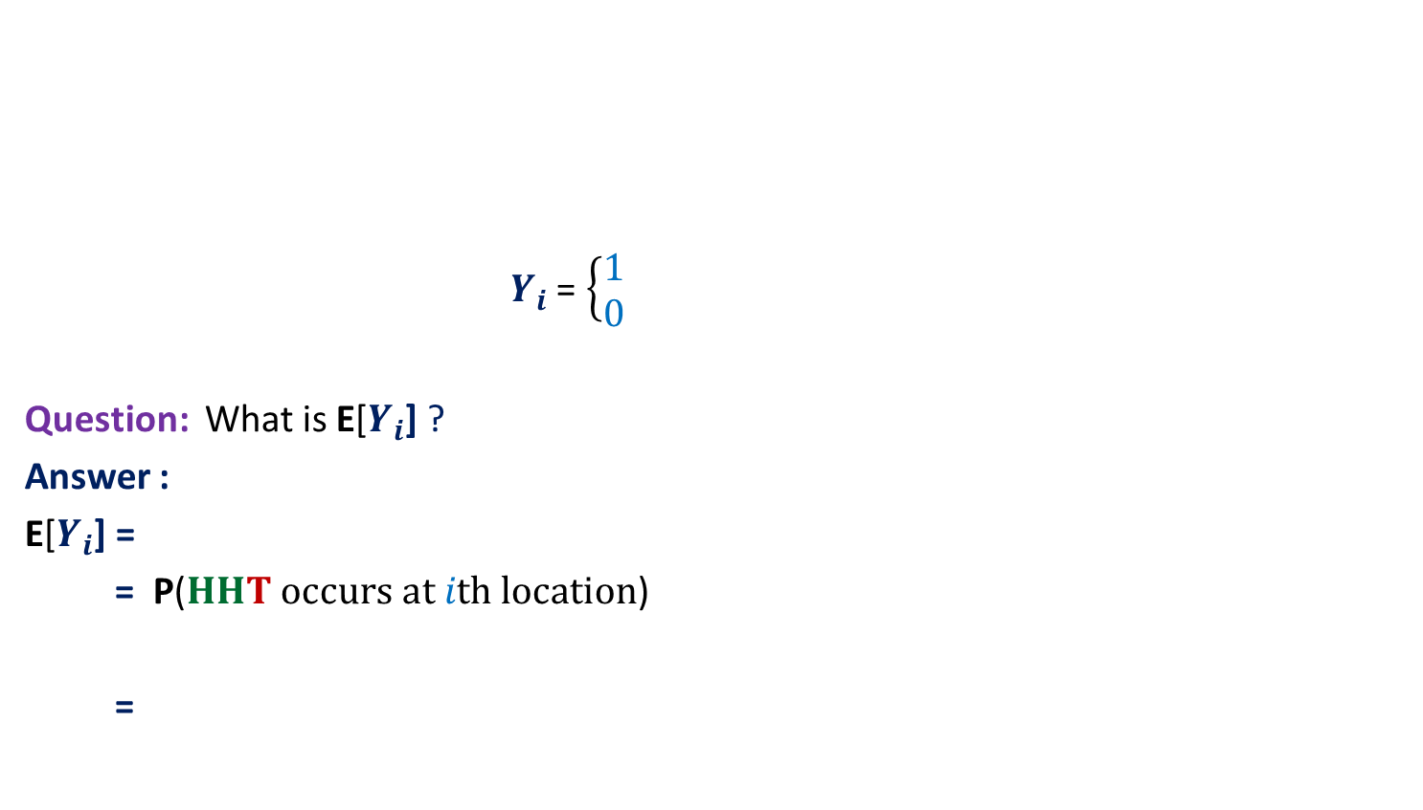








Problem 2: Pattern HHT in $n$ tosses of a fair coin
$Y_{i}$ = $\left\{\begin{matrix}1 \\ 0 \end{matrix}\right.$
Question: What is E[$Y_{i}$] ?
Answer :
E[$Y_{i}$] =
= $\text{P}\text{(}HHT occurs at ith location\text{)}$
=
$$i$$
H | T | … |  |  |  |  |  |  |  |  |  | H | H
H
H
T
$$if HHT occurs at ith location$$
What would you focus on while taking microscopic approach of this experiment?
$$otherwise$$
$1$ $∙$ $\text{(}HHT occur at ith location\text{) }$
+ $0$ $∙$ $\text{(}HHT {doesn}^{′}t occur at ith location$
We can define random variable $Y_{i}$ for each $1≤i≤n−2$
Does there exist any relation between $Y$ and $Y_{i}$’s ?
$$\frac{1}{2}$$
$$⋅\frac{1}{2}$$
Since outcome of each coin toss is independent of other coins, so …
$$⋅\frac{1}{2}$$
It is so easy and compact

Slide 12



Problem 2: Pattern HHT in $n$ tosses of a fair coin
$$n=14$$
Consider any elementary event.
$Y\left(ω\right)=$ ?
1 2 3 4 5 6 7 8 9 10 11 12 13 14
H | T | H | H | T | H | T | H | H | T | T | H | T | H
An elementary event
$$ω$$
number of times
HHT appears
$$2$$
$$Y_{1}(ω)$$ | $$Y_{2}(ω)$$ | $$Y_{3}(ω)$$ | $$Y_{4}(ω)$$ | $$Y_{5}(ω)$$ | $$Y_{6}(ω)$$ | $$Y_{7}(ω)$$ | $$Y_{8}(ω)$$ | $$Y_{9}(ω)$$ | $$Y_{10}(ω)$$ | $$Y_{11}(ω)$$ | $$Y_{12}(ω)$$ | $$Y_{13}(ω)$$ | $$Y_{14}(ω)$$
0
0
1
0
0
0
0
1
0
0
0
0
0
0
$Y\left(ω\right)=$ $Y_{1}\left(ω\right)+$ $Y_{2}\left(ω\right)+⋯$ $Y_{13}\left(ω\right)+$ $Y_{14}\left(ω\right)$
for each $ω$ ϵ Ω

Slide 13


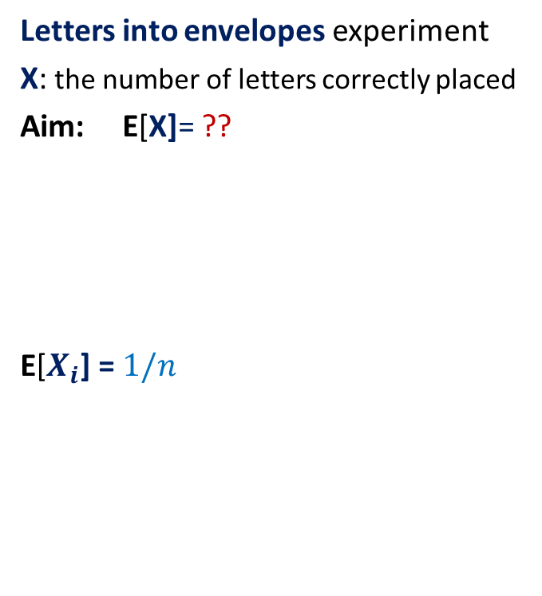
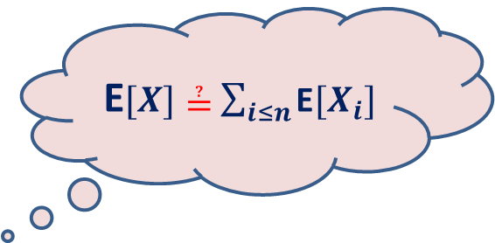
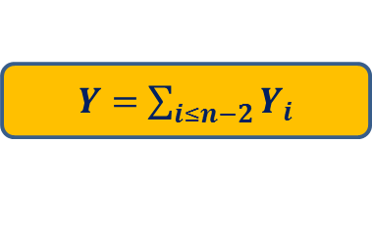
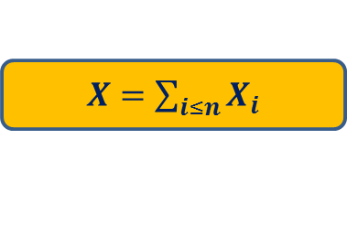
What have we learnt till now?
Letters into envelopes experiment
X: the number of letters correctly placed
Aim: E[X]= ??
E[$X_{i}$] = $1/n$
Pattern HHT in n coin tosses
Y: the number of times HHT appears
Aim: E[Y]= ??
E[$Y_{i}$] = $\frac{1}{8}$
$X=$ $\sum_{i≤n}{X_{i}}$
$Y=$ $\sum_{i≤n−2}{Y_{i}}$
E$[X]≟$ $\sum_{i≤n}{\text{E}[X_{i}]}$
E$[Y]≟$ $\sum_{i≤n−2}{\text{E}[Y_{i}]}$

Slide 14
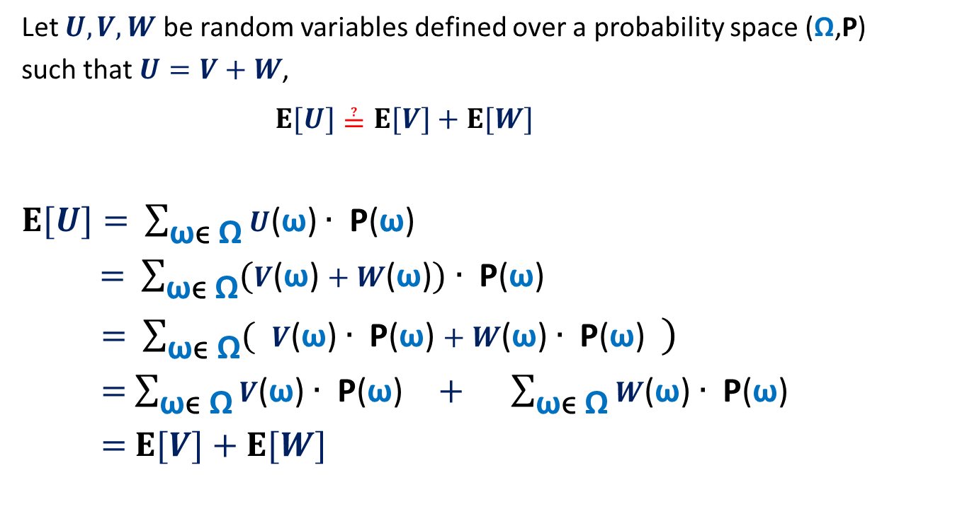
The main question ?
Let $U,V,W$ be random variables defined over a probability space (Ω,P)
such that $U=V+W$,
$E[U]≟E[V]+E[W]$
$E[U]=$ $\sum_{\text{ω}\text{ϵ} \text{Ω}}{U\text{(}\text{ω}\text{)}∙ \text{P}\text{(}\text{ω}\text{)}}$
$=$ $\sum_{\text{ω}\text{ϵ} \text{Ω}}{(V\text{(}\text{ω}\text{)}+W\text{(}\text{ω}\text{)})∙ \text{P}\text{(}\text{ω}\text{)}}$
$=$ $\sum_{\text{ω}\text{ϵ} \text{Ω}}{( V\text{(}\text{ω}\text{)}∙ \text{P}\text{(}\text{ω}\text{)}+W\text{(}\text{ω}\text{)}∙ \text{P}\text{(}\text{ω}\text{)} )}$
$=$ $\sum_{\text{ω}\text{ϵ} \text{Ω}}{V\text{(}\text{ω}\text{)}∙ \text{P}\text{(}\text{ω}\text{)}} + \sum_{\text{ω}\text{ϵ} \text{Ω}}{W\text{(}\text{ω}\text{)}∙ \text{P}\text{(}\text{ω}\text{) }}$
$=$ $E[V]+E[W]$

Slide 15

Problem 1: Letters and envelopes
$X$ : the number of no. of letters correctly placed.
$X=$ $\sum_{i≤n}{X_{i}}$
Using Linearity of Expectation
$E$[$X$] $=\sum_{i≤n}{E[X_{i}]}$
$=\sum_{i≤n}{ \frac{1}{n}}$
$=$ $1$

Slide 16
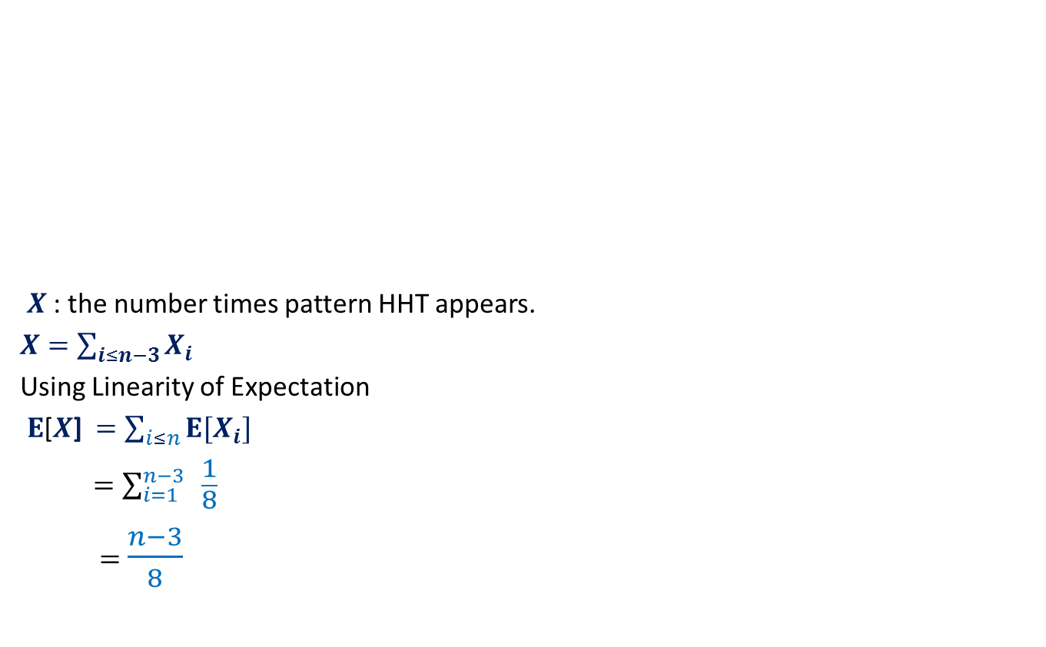

Problem 2: Pattern HHT in $n$ tosses of a fair coin
$X$ : the number times pattern HHT appears.
$X=$ $\sum_{i≤n−3}{X_{i}}$
Using Linearity of Expectation
$E$[$X$] $=\sum_{i≤n}{E[X_{i}]}$
$=\sum_{i=1}^{n−3}{ \frac{1}{8}}$
$=$ $\frac{n−3}{8}$
H | T | … |  |  |  |  |  |  |  |  |  | H | H

Slide 17
Homework from today’s class
Solve Problem 3 using linearity of expectation.
Try to ponder over the following questions ?
Why does the linearity of expectation holds irrespective of the probability distribution of the random variables ?
Why does the linearity of expectation holds irrespective of the dependence/independence among the constituent random variables ?
Suppose we define “product of random variables” in a similar fashion. Will the same property holds there as well ?

